Slide 1
Interaction and NLP Based Sentiment Analysis of Bangla Food Review in Social Media
Group Member(s)
Ataf Fazledin Ahamed
S201705066
Department of CSE, BUET
Supervisor
Dr. Sadia Sharmin
Associate Professor
Department of CSE, BUET

Slide 2
Motivation

Slide 3
Motivation
[1] DataReportal: Digital 2023: Bangladesh — DataReportal – Global Digital Insights

Slide 4
Motivation | Facebook
News
Entertainment
Marketplace
Advertisement

Slide 5
Related Works

Slide 6
Related Works | Facebook Domain
[1] Interaction Based Credibility Analysis of News on Facebook Using Machine Learning Methodologies
Sudipa Saha, Tasin Hoque, Khandaker Abrar Nadib
2022 Undergraduate Thesis, Department of CSE, BUET
[2] Sentiment Analysis on Bengali Facebook Comments To Predict Fan's Emotions Towards a Celebrity
Serajus Salekin, et. al
2021 Journal of Engineering Advancements Vol. 02
https://doi.org/10.38032/jea.2021.03.001
[3] Hateful Speech Detection in Public Facebook Pages for the Bengali Language
Alvi Md Ishmam, Sadia Sharmin
2019 18th IEEE International Conference On Machine Learning And Applications (ICMLA)
https://doi.org/10.1109/ICMLA.2019.00104

Slide 7
Related Works | Facebook Domain
[1] Interaction Based Credibility Analysis of News on Facebook Using Machine Learning Methodologies
Sudipa Saha, Tasin Hoque, Khandaker Abrar Nadib
2022 Undergraduate Thesis, Department of CSE, BUET
[2] Sentiment Analysis on Bengali Facebook Comments To Predict Fan's Emotions Towards a Celebrity
Serajus Salekin, et. al
2021 Journal of Engineering Advancements Vol. 02
https://doi.org/10.38032/jea.2021.03.001
[3] Hateful Speech Detection in Public Facebook Pages for the Bengali Language
Alvi Md Ishmam, Sadia Sharmin
2019 18th IEEE International Conference On Machine Learning And Applications (ICMLA)
https://doi.org/10.1109/ICMLA.2019.00104

Slide 8
Related Works | Facebook Domain
[1] Interaction Based Credibility Analysis of News on Facebook Using Machine Learning Methodologies
Sudipa Saha, Tasin Hoque, Khandaker Abrar Nadib
2022 Undergraduate Thesis, Department of CSE, BUET
[2] Sentiment Analysis on Bengali Facebook Comments To Predict Fan's Emotions Towards a Celebrity
Serajus Salekin, et. al
2021 Journal of Engineering Advancements Vol. 02
https://doi.org/10.38032/jea.2021.03.001
[3] Hateful Speech Detection in Public Facebook Pages for the Bengali Language
Alvi Md Ishmam, Sadia Sharmin
2019 18th IEEE International Conference On Machine Learning And Applications (ICMLA)
https://doi.org/10.1109/ICMLA.2019.00104

Slide 9
Related Works | Food Review Domain
[1] Sentiment Analysis Techniques on Food Reviews Using Machine Learning
Shilpa Gite, et al.
2021 Proceedings of Second International Conference on Computing, Communications, and Cyber-Security
https://doi.org/10.1007/978-981-16-0733-2_36
[2] Sentiment Analysis on Food Review using Machine Learning Approach
Nourin Islam, et al.
2021 Journal of Engineering Advancements Vol. 02
https://doi.org/10.38032/jea.2021.03.001
[3] Sentiment Analysis of Bengali Texts on Online Restaurant Reviews Using Multinomial Naive Bayes
Omar Sharif, et al.
2019 1st International Conference on Advances in Science, Engineering and Robotics Technology
https://doi.org/10.1109/ICASERT.2019.8934655

Slide 10


Related Works | Food Review Domain
[1] Sentiment Analysis Techniques on Food Reviews Using Machine Learning
Shilpa Gite, et al.
2021 Proceedings of Second International Conference on Computing, Communications, and Cyber-Security
https://doi.org/10.1007/978-981-16-0733-2_36

Slide 11

Related Works | Food Review Domain
[2] Sentiment Analysis on Food Review using Machine Learning Approach
Nourin Islam, et al.
2021 Journal of Engineering Advancements Vol. 02
https://doi.org/10.38032/jea.2021.03.001

Slide 12

Related Works | Food Review Domain
[3] Sentiment Analysis of Bengali Texts on Online Restaurant Reviews Using Multinomial Naive Bayes
Omar Sharif, et al.
2019 1st International Conference on Advances in Science, Engineering and Robotics Technology
https://doi.org/10.1109/ICASERT.2019.8934655

Slide 13
Problem

Slide 14



Problem
Language
Platform
Content

Slide 15
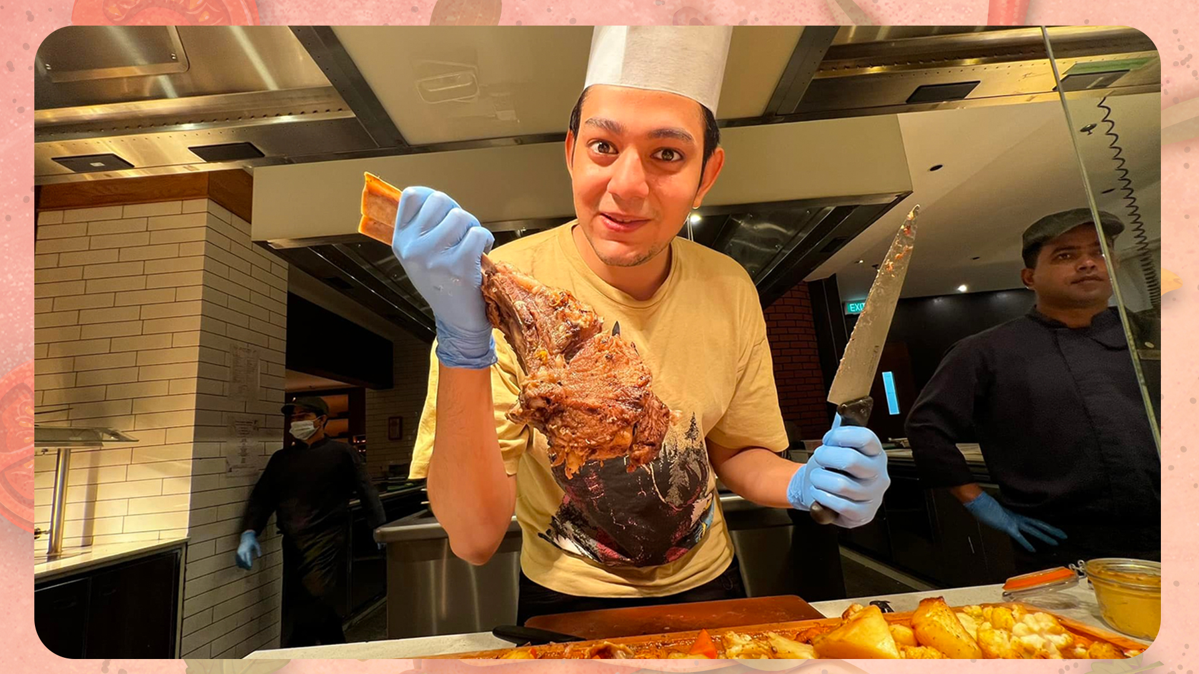


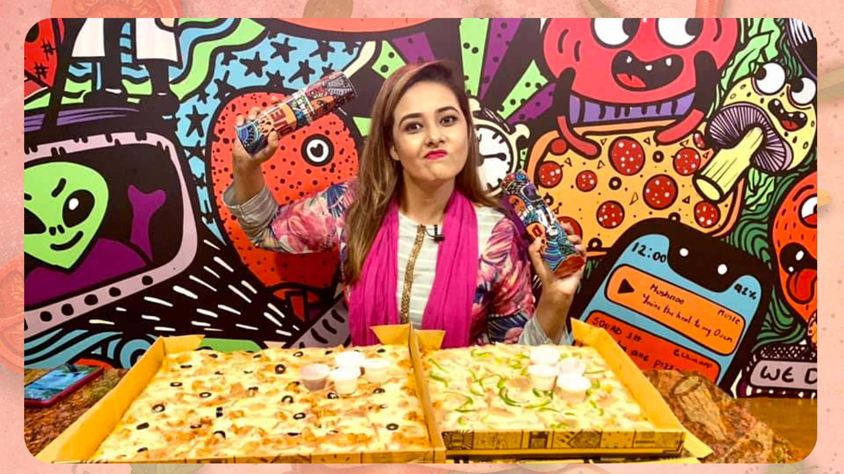
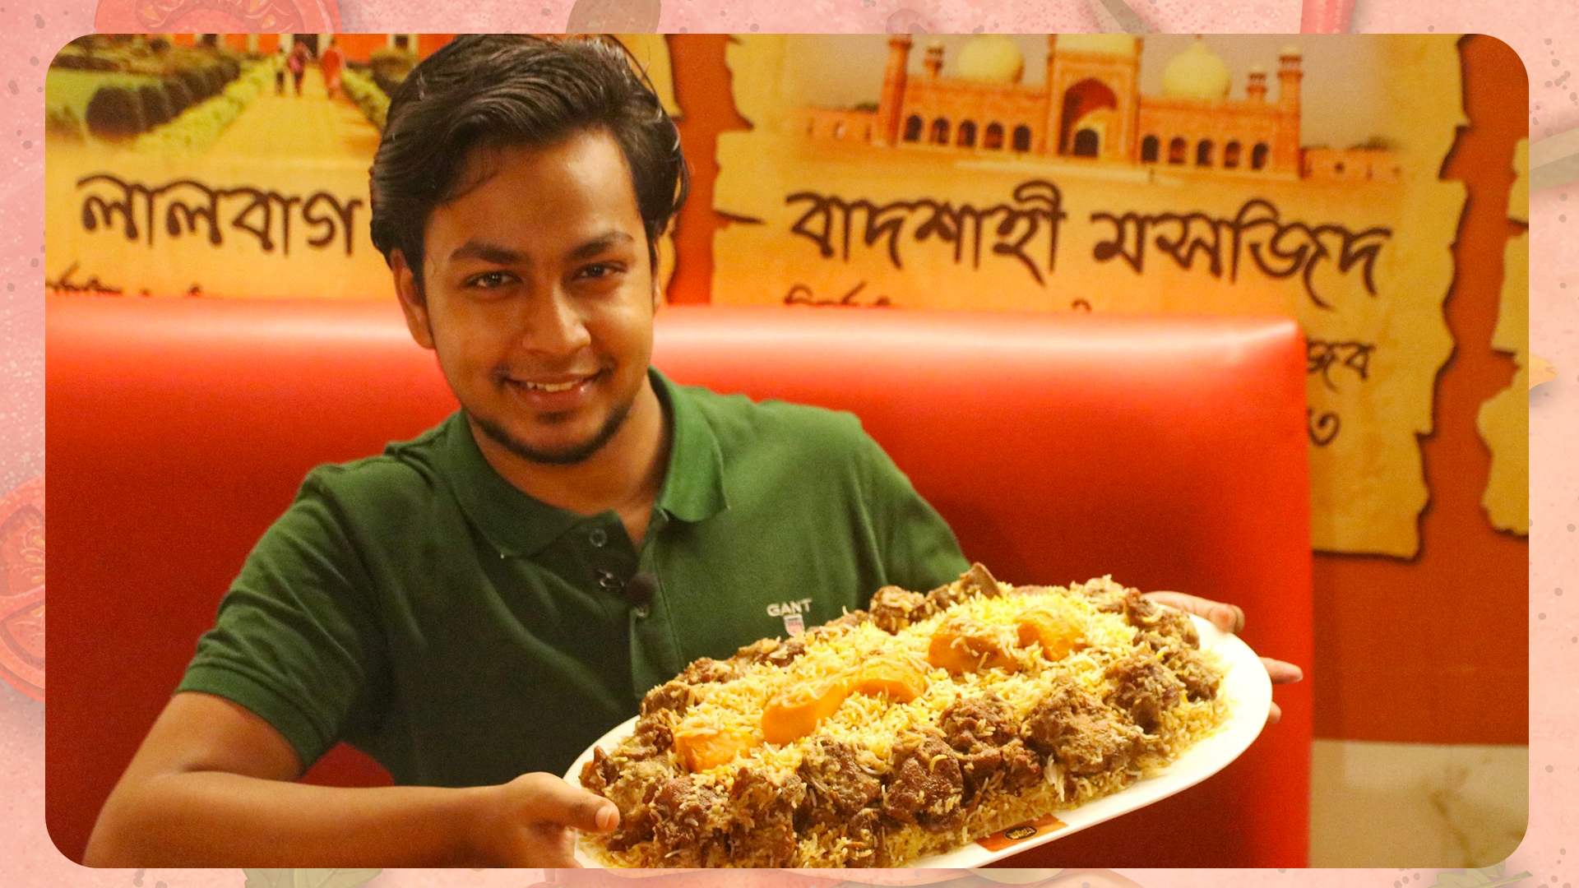
Problem | Bangladeshi Top Food Vloggers & Influencers
Rafsan The Chotobhai
Khudalagse
Petuk Couple
Zoltan BD
Metroman
Followers:
3.2 M
Platform:
Facebook
YouTube
Followers:
1.5 M
Platform:
Facebook
YouTube
Followers:
1.8 M
Platform:
Facebook
YouTube
Followers:
672 K
Platform:
Facebook
YouTube
Followers:
668 K Platform:
Facebook
YouTube
Instagram
[1] HypeScout Stories: Bangladeshi Top Food Vloggers and Influencers (hypescout.co)

Slide 16
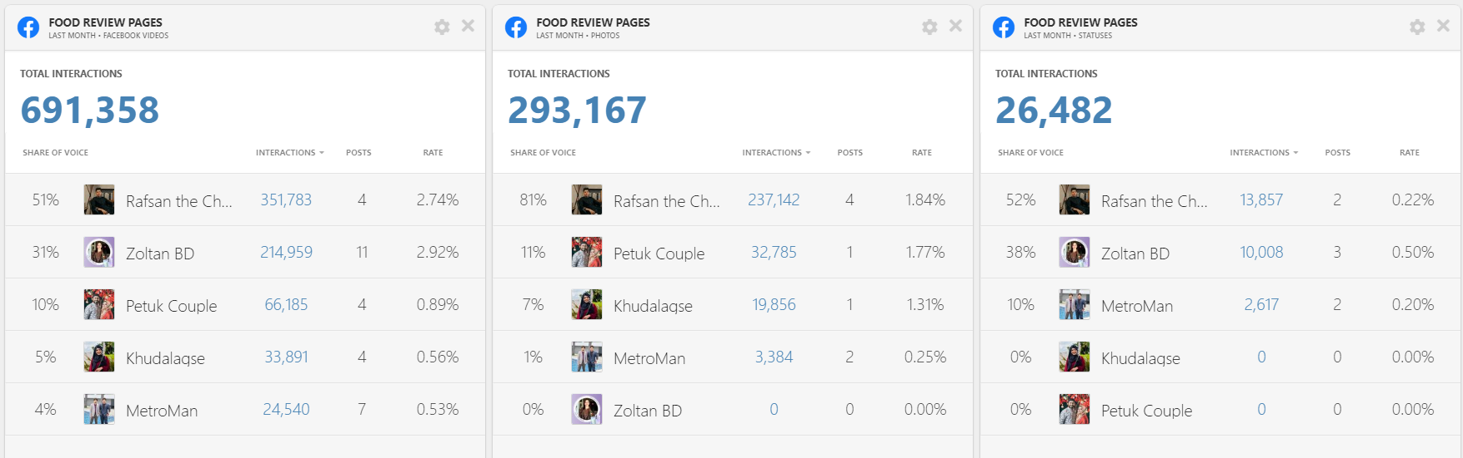
Problem
Video Contents have a high interaction rate!

Slide 17
Data Collection & Pre-processing

Slide 18
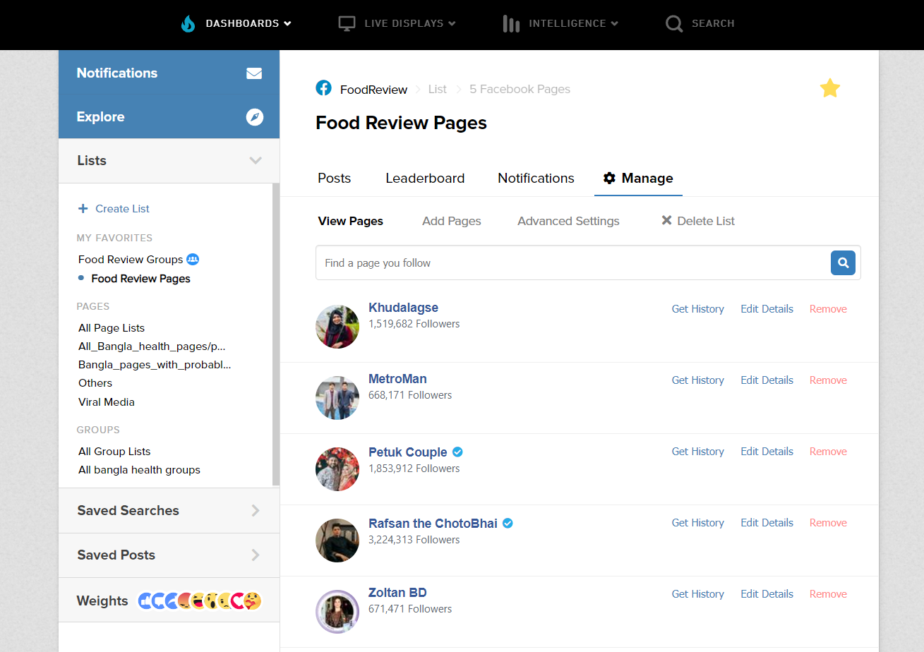

Data Collection & Pre-processing
Social Media analytics tool by Meta (Facebook Inc.)
Download CSV of Facebook posts of a page/group
[1] https://apps.crowdtangle.com

Slide 19
Data Collection & Pre-processing
CrowdTangle Data
Downloaded data is filtered based on some criteria-
Post type (Video)
Date range (2020 – 2022)
Owned
Actual food review video
Filtered manually
Likes
Love
Wow
Haha
Sad
Angry
Care
Post Created Date
Post Created Time
Type
Total Interactions
Total Comments
Shares
Total Views
Video Length
Message
Link
Score

Slide 20
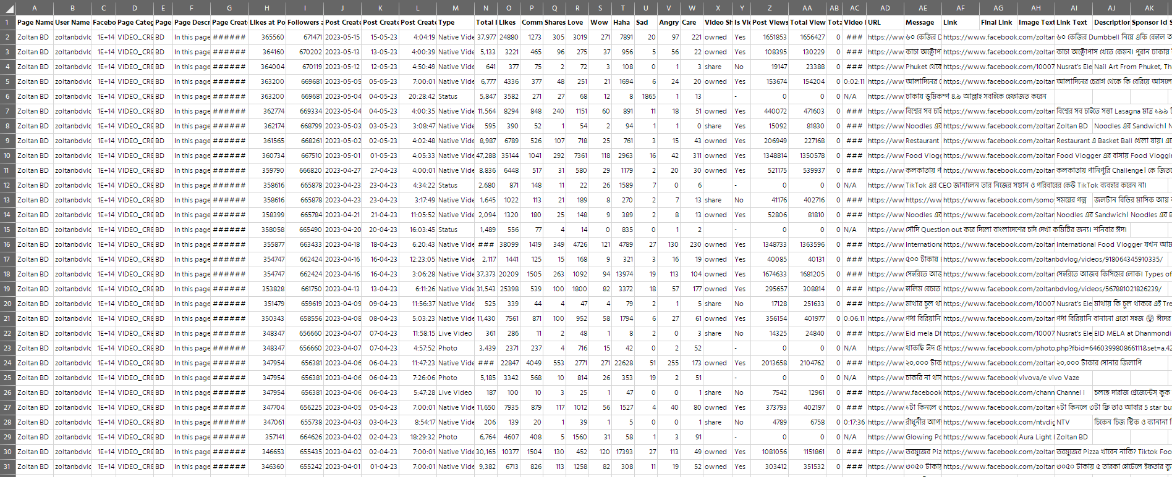
Data Collection & Pre-processing

Slide 21
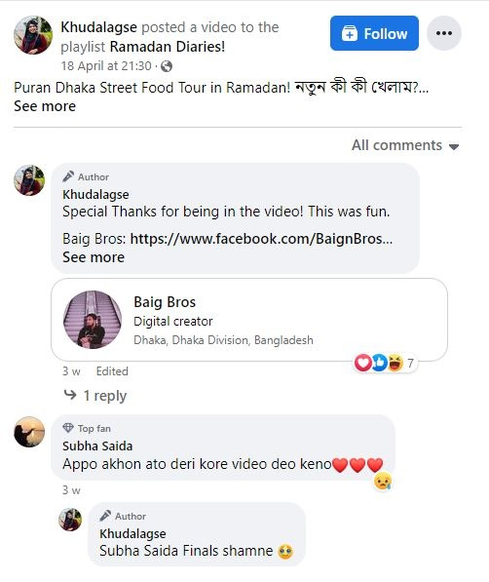
Data Collection & Pre-processing
Comments for each Facebook Videos are downloaded
20-30 comments per post
Comments Language
Bangla
English
Banglish

Slide 22
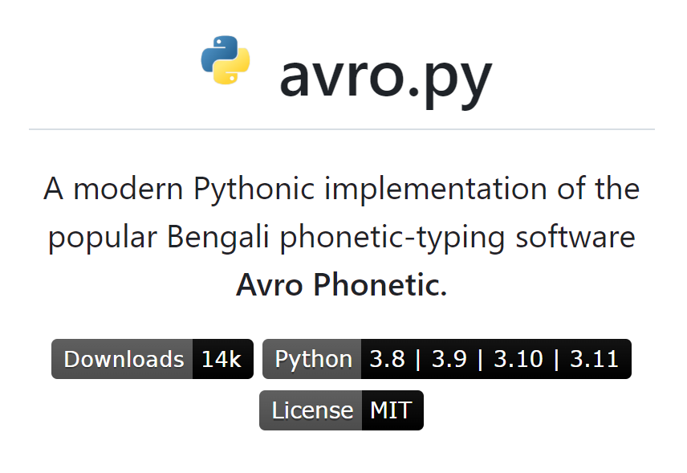


Data Collection & Pre-processing
Google Translate API
Comments are passed through avro.py parser
Parsed Bangla text is sent to API for further cleaning
Another level of human text filtering is done
[1] hitblast/avro.py: A modern Pythonic implementation of Avro Phonetic. (github.com)

Slide 23
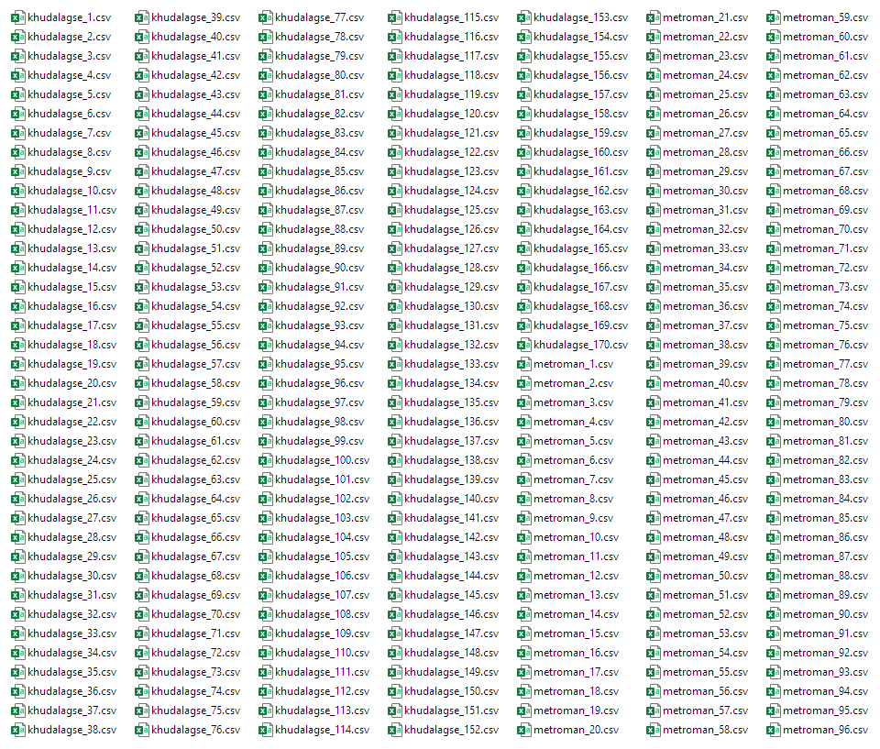
Data Collection & Pre-processing
Total Downloaded Dataset Size
Total Posts : 905
Total Comments : 26,004

Slide 24
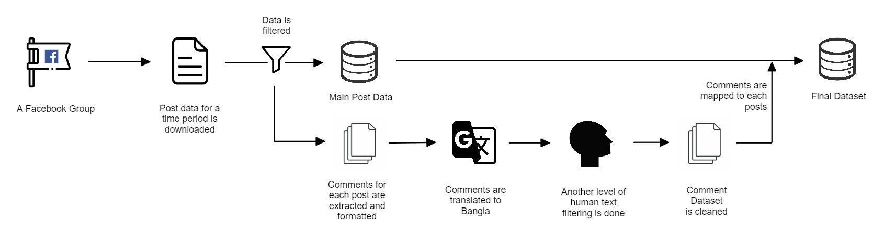
Data Collection & Pre-processing
Fig: Data collection and pre-processing steps

Slide 25
Methodology

Slide 26

Methodology
Classify Facebook Comments- positive/negative
SentNoB Dataset
ABSA Dataset
Online Restaurant Reviews Dataset
BanglaBERT
Pretrained model from BUET CSE NLP Group for Sequence Classification
Fine-tuned for Sequence Classification on 3 datasets
Classify the comments as either positive or negative
[1] csebuetnlp/banglabert
[2] SentNoB | Kaggle
[3] https://doi.org/10.3390/data3020015
[4] https://github.com/eftekhar-hossain/Bengali-Restaurant-Reviews/

Slide 27
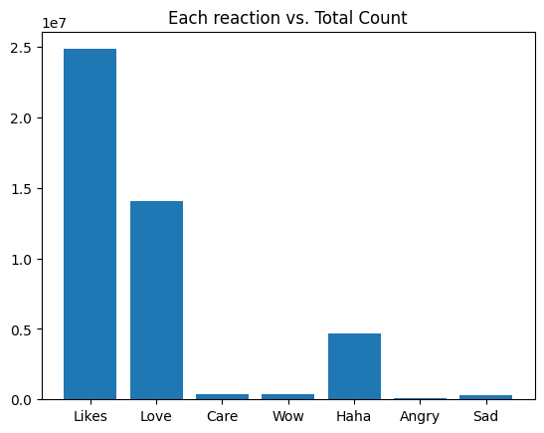
Methodology
Discarded Like reaction
Facebook News Feed Ranking gives less importance to “Like”
Like count is almost equal to sum of other reactions
[1] How Does News Feed Predict What You Want to See? | Meta (fb.com)

Slide 28
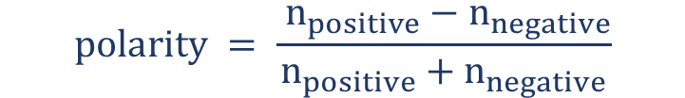
Methodology
Special Reactions Based Scoring System
Positive
Negative
Pratama, Ahmad. (2022). “Sentiment Analysis of Facebook Posts through Special Reactions: The Case of Learning from Home in Indonesia Amid COVID-19”. Jurnal Ilmiah Teknik Elektro Komputer dan Informatika. 8. 83-92. 10.26555/jiteki.v8i1.23615.
C. Freeman, M. K. Roy, M. Fattoruso and H. Alhoori, "Shared Feelings: Understanding Facebook Reactions to Scholarly Articles," 2019 ACM/IEEE Joint Conference on Digital Libraries (JCDL), Champaign, IL, USA, 2019, pp. 301-304, doi: 10.1109/JCDL.2019.00050.
$$n_{positive}=Sum of all positive reactions$$
$$n_{negative}=Sum of all negative reactions$$
$$polarity = \frac{ n_{positive}−n_{negative}}{n_{positive}+n_{negative}}$$

Slide 29
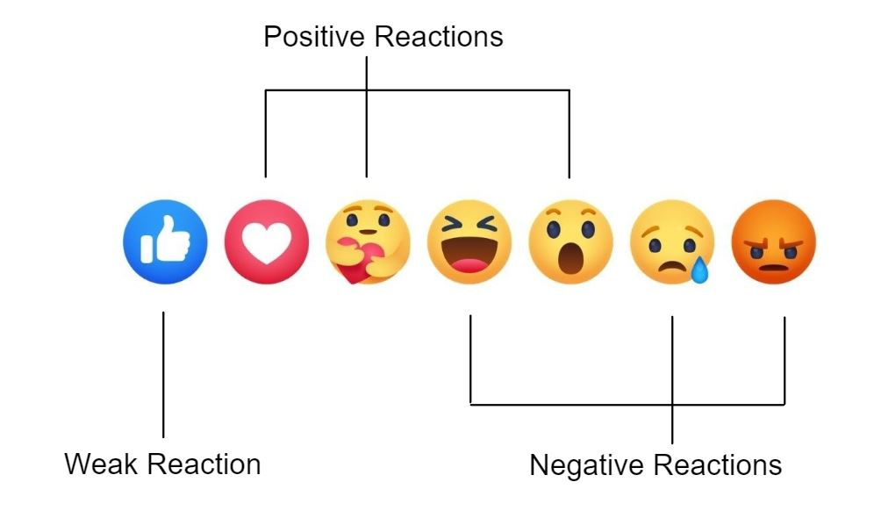
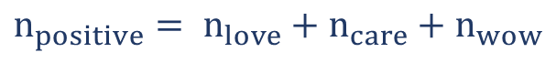
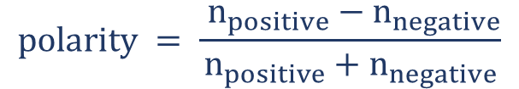
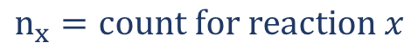

Methodology
Reaction Classification
Positive: Love, Care, Wow
Negative: Haha, Angry, Sad
$$n_{x}=count for reaction x$$
$$n_{positive}= n_{love}+n_{care}+n_{wow}$$
$$n_{negative}= n_{haha}+n_{angry}+n_{sad}$$
$$polarity = \frac{ n_{positive}−n_{negative}}{n_{positive}+n_{negative}}$$

Slide 30
Methodology
Divide into four classes based on Polarity Value
Polarity Value
-1.0 -0.5 0 +0.5 +1.0
class 0
class 1
class 2
class 3

Slide 31
Results

Slide 32
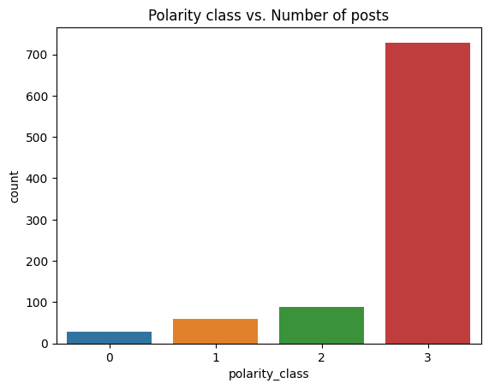
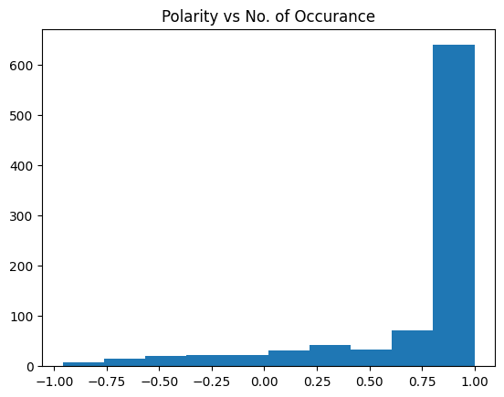
Results

Slide 33
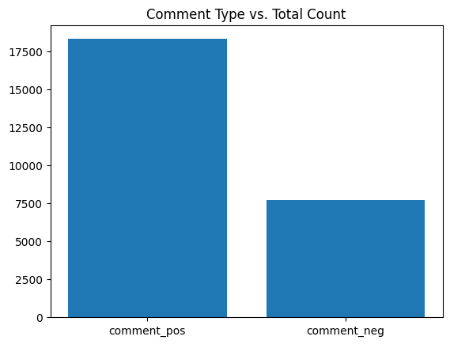
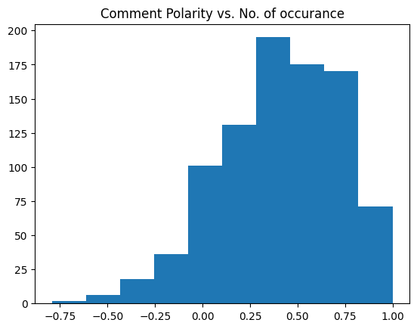
Results

Slide 34
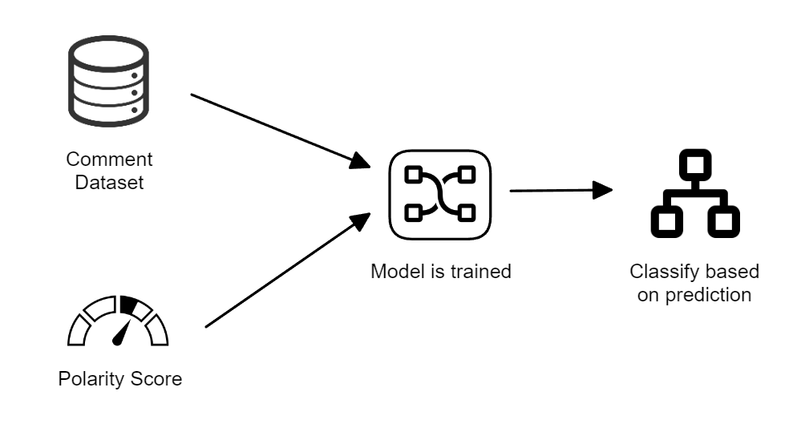
Results
Dataset is split 70/30
Comments classes-
Positive
Negative
Features (X)
No. of positive comments
No. of negative comments
Output (y)
Polarity class

Slide 35
Results
Classifier Model | Accuracy | Macro F1 | Weighted F1
Logistic Regression | 0.79 | 0.22 | 0.69
Random Forest | 0.77 | 0.22 | 0.69
Support Vector | 0.79 | 0.22 | 0.69
Decision Tree | 0.79 | 0.22 | 0.69
Neural Network | 0.79 | 0.22 | 0.69
Fig: Metrics of models’ performance

Slide 36
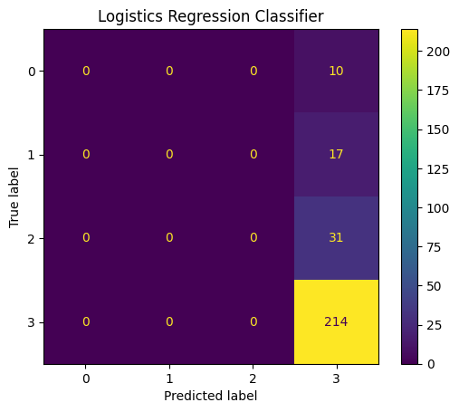

Results

Slide 37


Results

Slide 38
Contributions

Slide 39
Contributions
Bangla Food Review in Social Media Dataset
905 posts, 26004 lines of comments
Findings
Most of the Bangla Food Review (2020-22) sentiments are positive
Tools
Chrome Free Plugin for Scraping Facebook Comments

Slide 40
Future Work
Bangla Food Review in Social Media Groups
Might lead to more balanced datapoints

Slide 41
Thank you

Slide 42
Appendix

Slide 43
Motivation
[1] DataReportal: Digital 2023: Bangladesh — DataReportal – Global Digital Insights

Slide 44
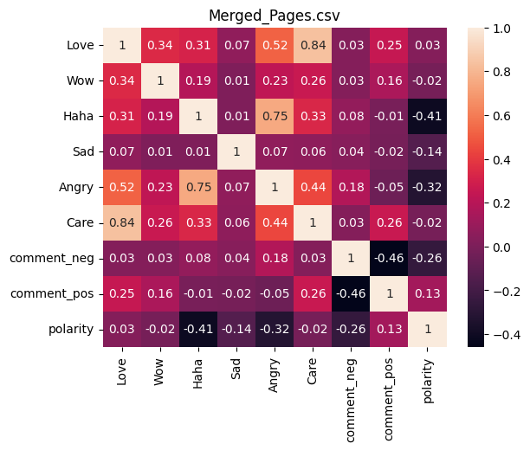
Methodology
Correlation Coefficient of All Features
Strong correlation between-
Love & Care
Haha & Angry
Fig: Correlation co-efficient of features of all datapoints

Slide 45
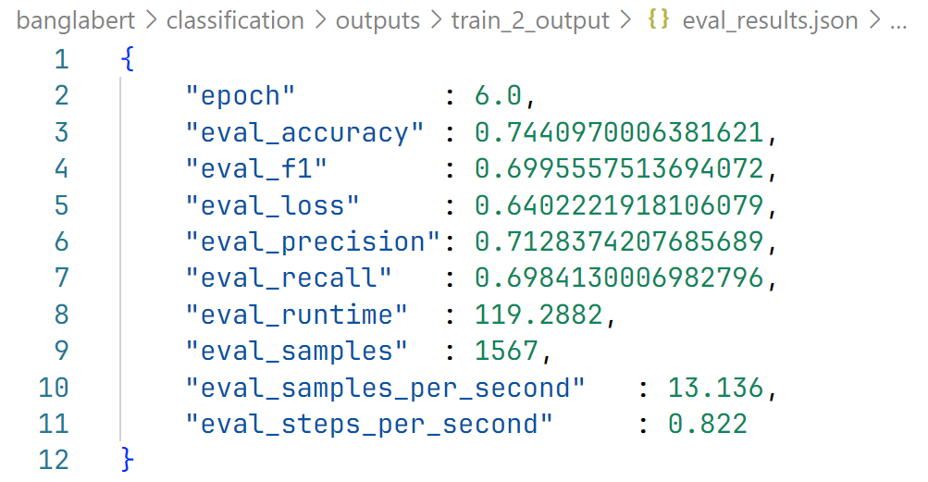
BanglaBERT Score
Evaluation Results of BanglaBERT

Slide 46
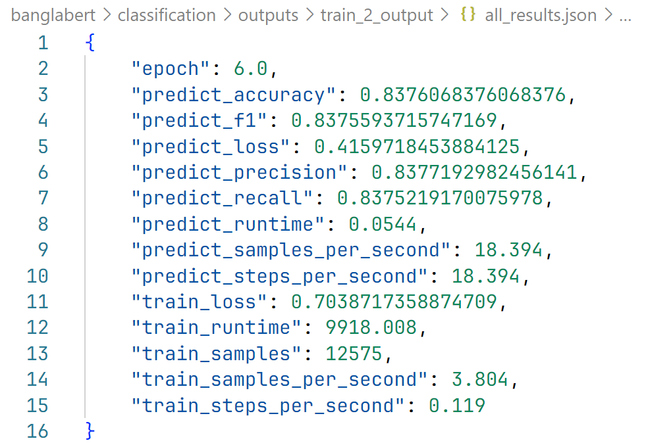
BanglaBERT Score
Evaluation Results of BanglaBERT

Slide 47
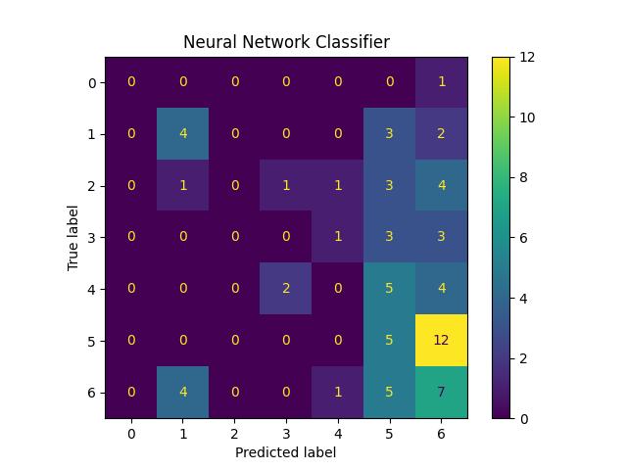
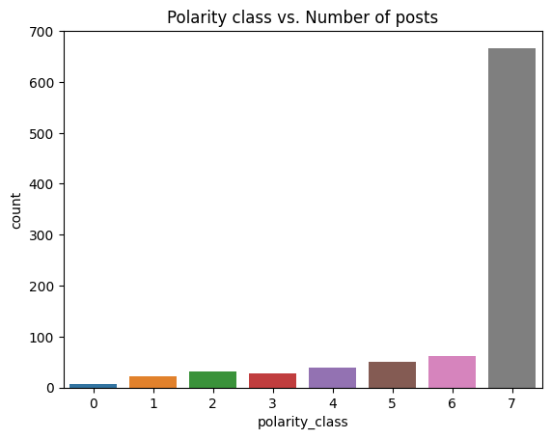
Neural Network w/o class 7
Confusion Matrix of Neural Network w/o class 7 data, Epoch = 200

Slide 48
Problem
Food Review Ecosystem
Platform
Facebook
Apps
Language
Bangla
FoodPanda
Hungrynaki
English
Pages
Groups
Content
Video
Others

Slide 49
Problem
Food Review Ecosystem
Platform
Facebook
Apps
Language
Bangla
FoodPanda
Hungrynaki
English
Pages
Groups
Content
Video
Others

Slide 50
Problem
Food Review Ecosystem
Platform
Facebook
Apps
Language
Bangla
FoodPanda
Hungrynaki
English
Pages
Groups
Content
Video
Others

